Slide 1
UCSD Embedded C Assignment 1
By
Hsuankai Chang
hsuankac@umich.edu

Slide 2
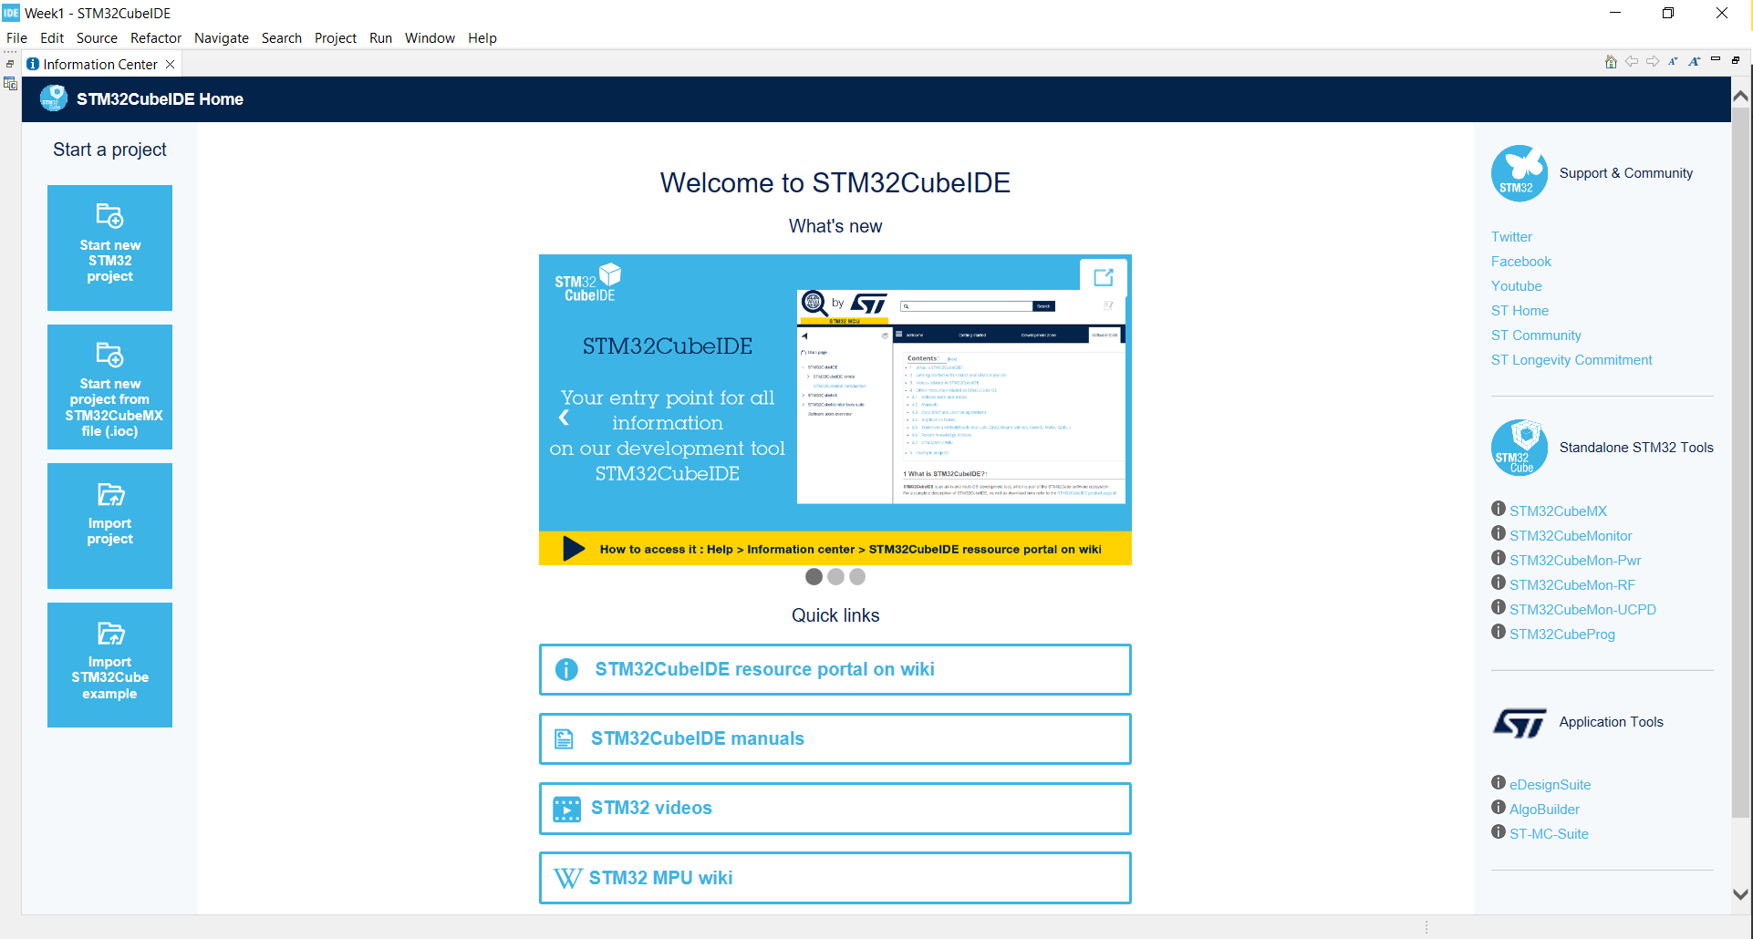
Step 1. Startup STM32CubeIDE

Slide 3
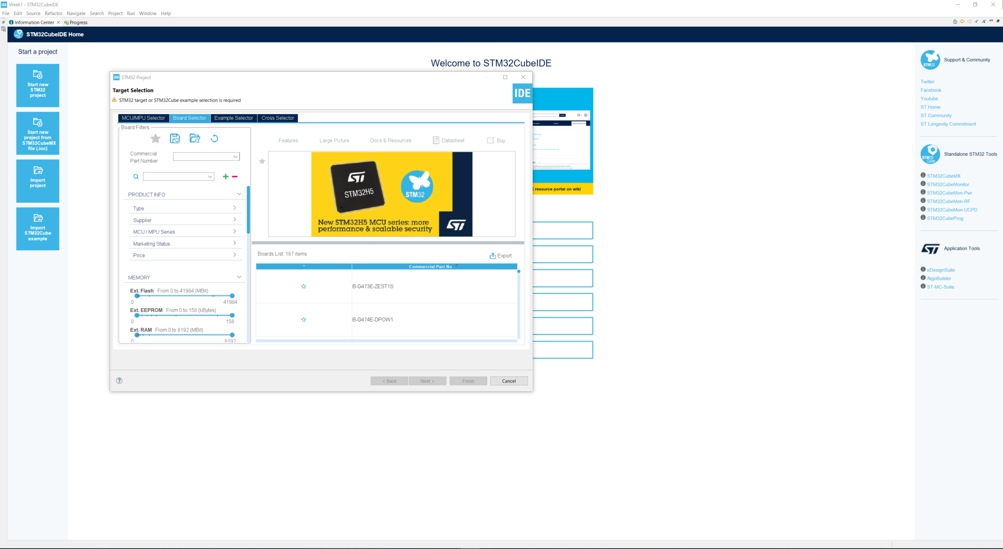
Step 2. Click Start new STM32 Project

Slide 4
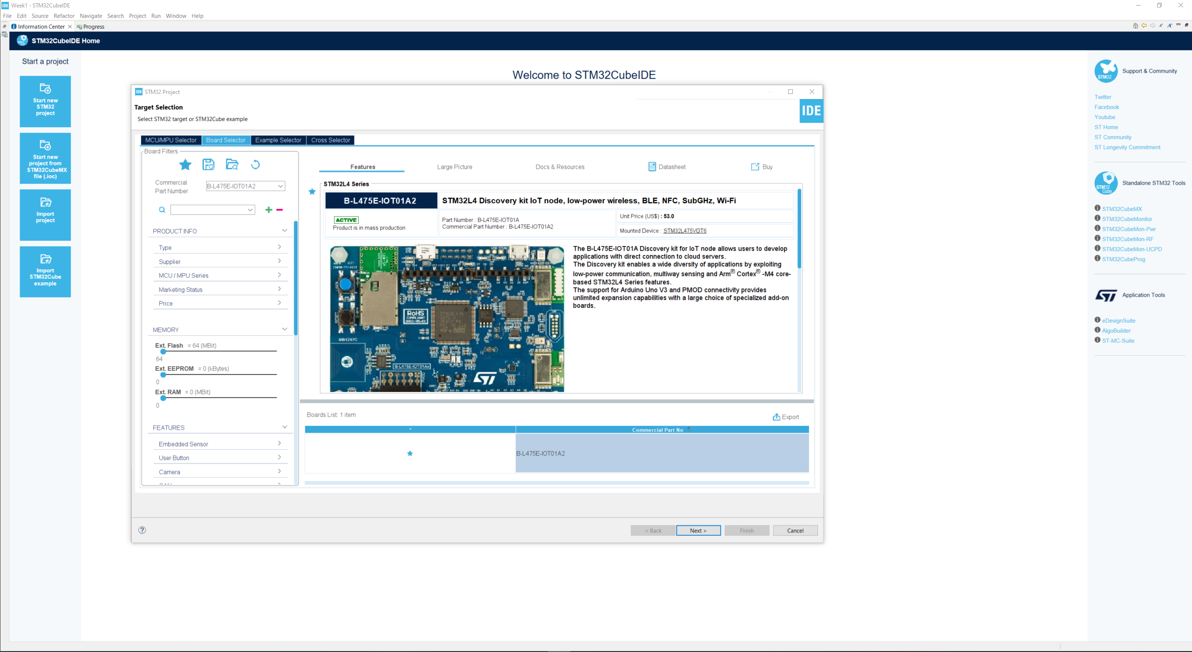
Step 3. Type in the board you use, click Next

Slide 5
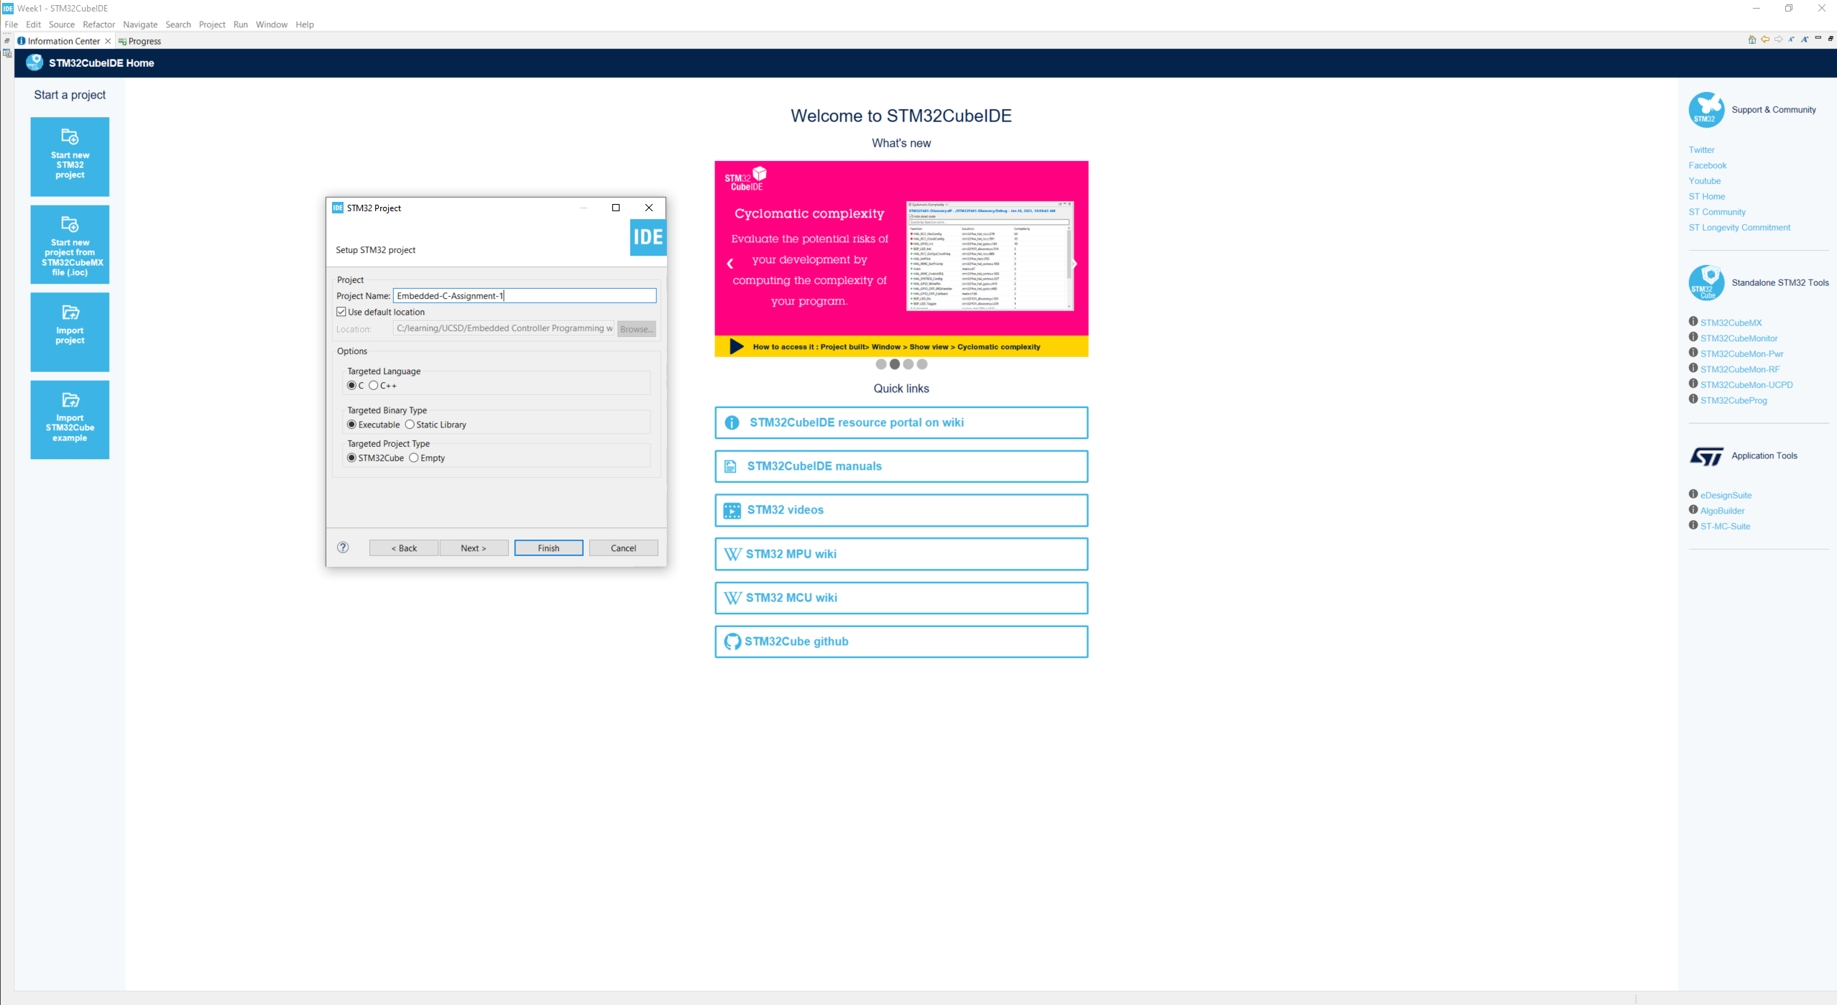
Step 4. Enter the project name then click Finish

Slide 6
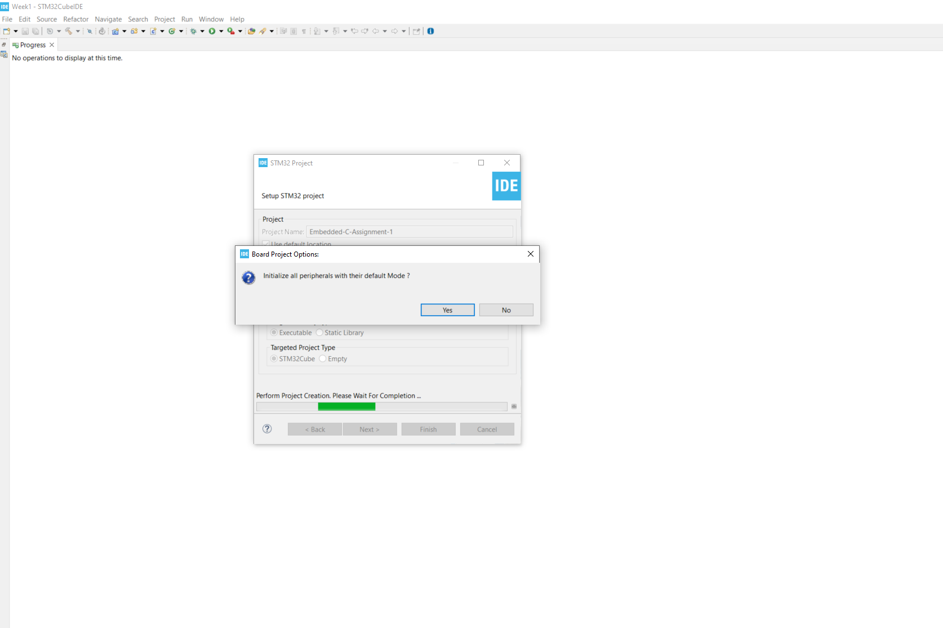
Step 5. Click yes to initialize all peripherals to default

Slide 7
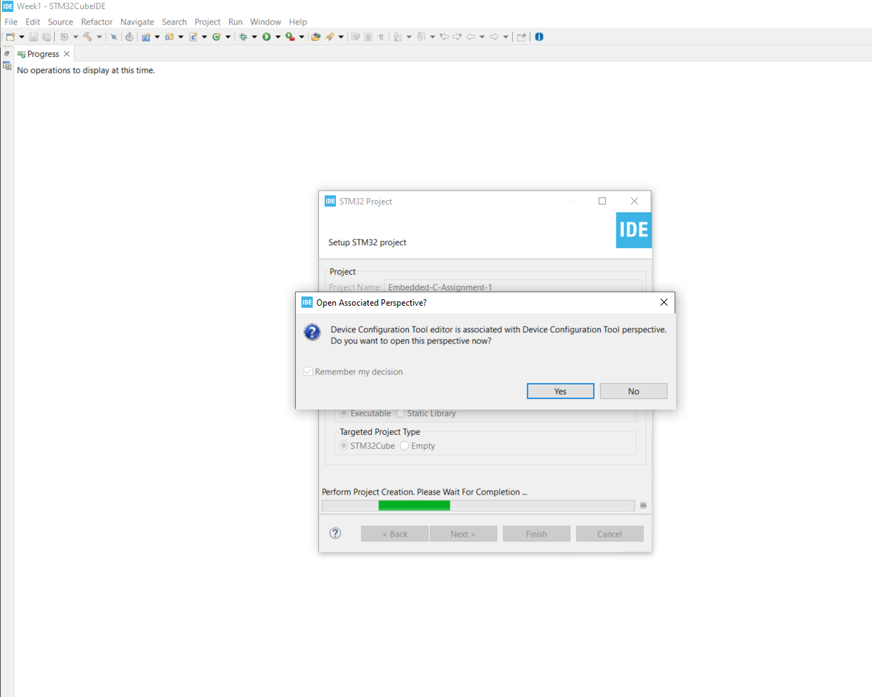
Step 6. Click yes to open perspective

Slide 8
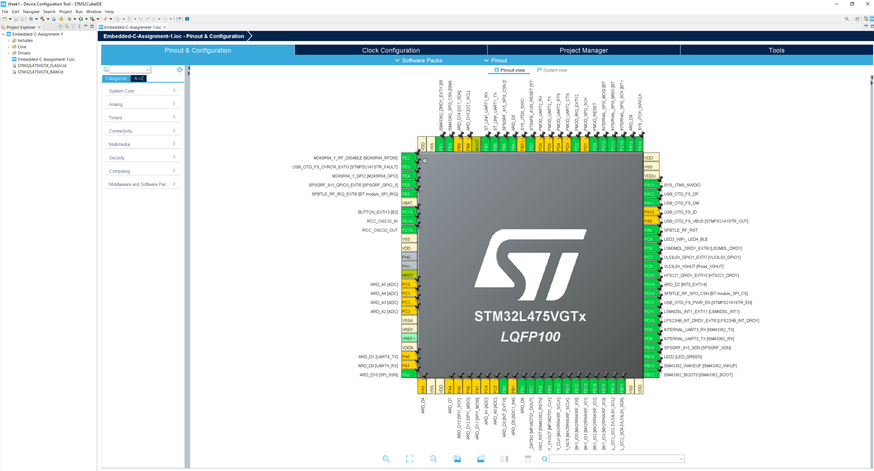
Step 7. Observe results in the .ioc file

Slide 9
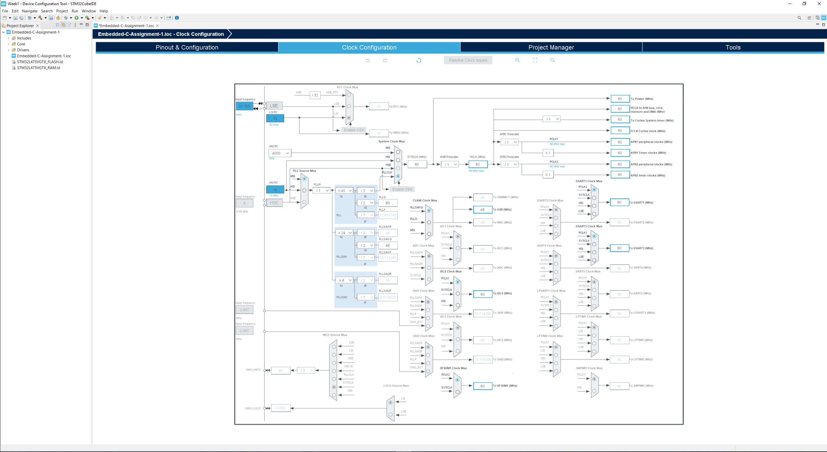
Step 8. Review the clock configuration

Slide 10
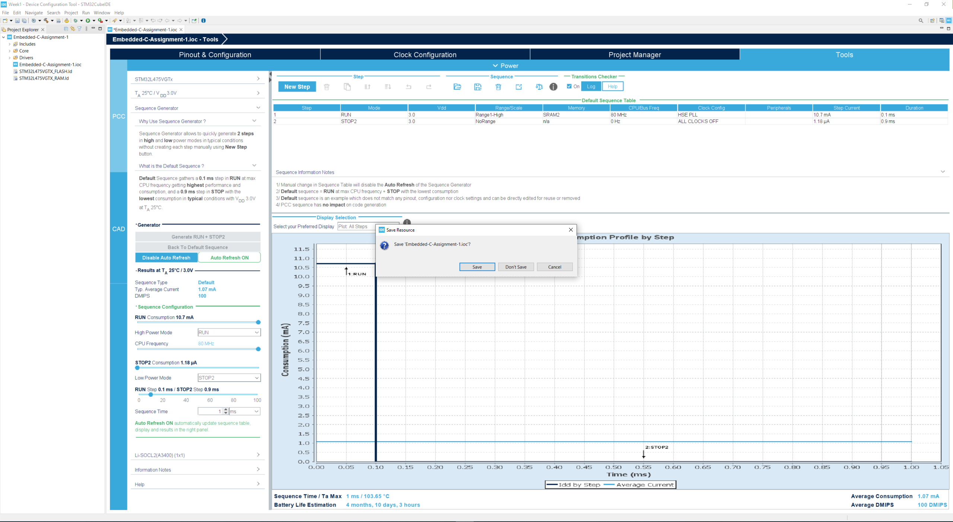
Step 9. Save the .ioc file

Slide 11
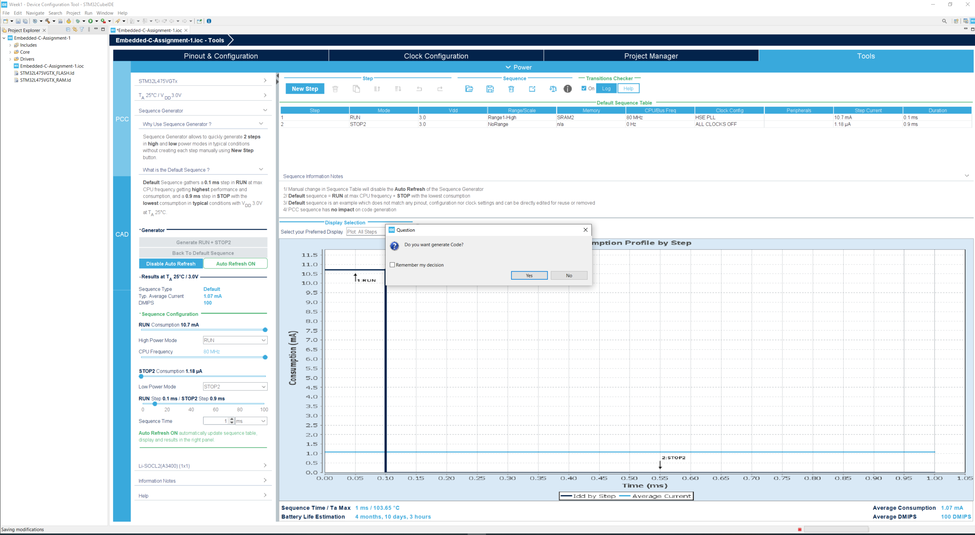
Step 10. Click yes to generate code

Slide 12
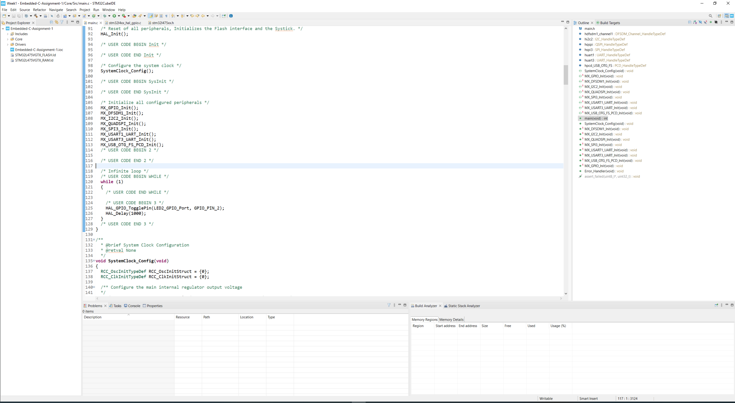
Step 11. Add LED toggle and delay code

Slide 13
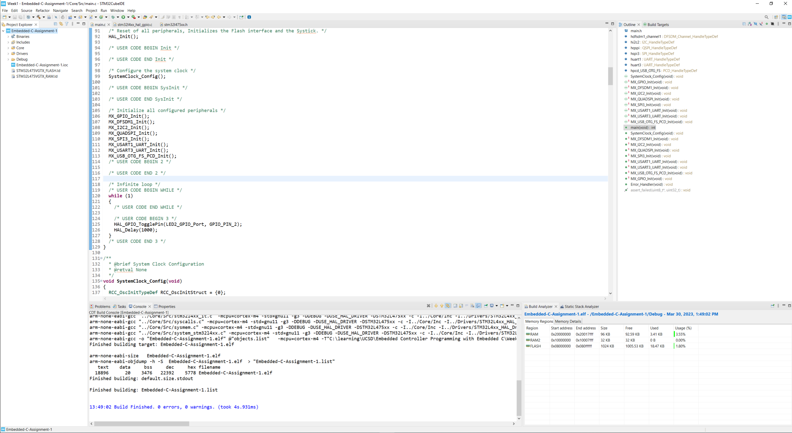
Step 12. Right click on the project name and build it, test the .elf file

Slide 14
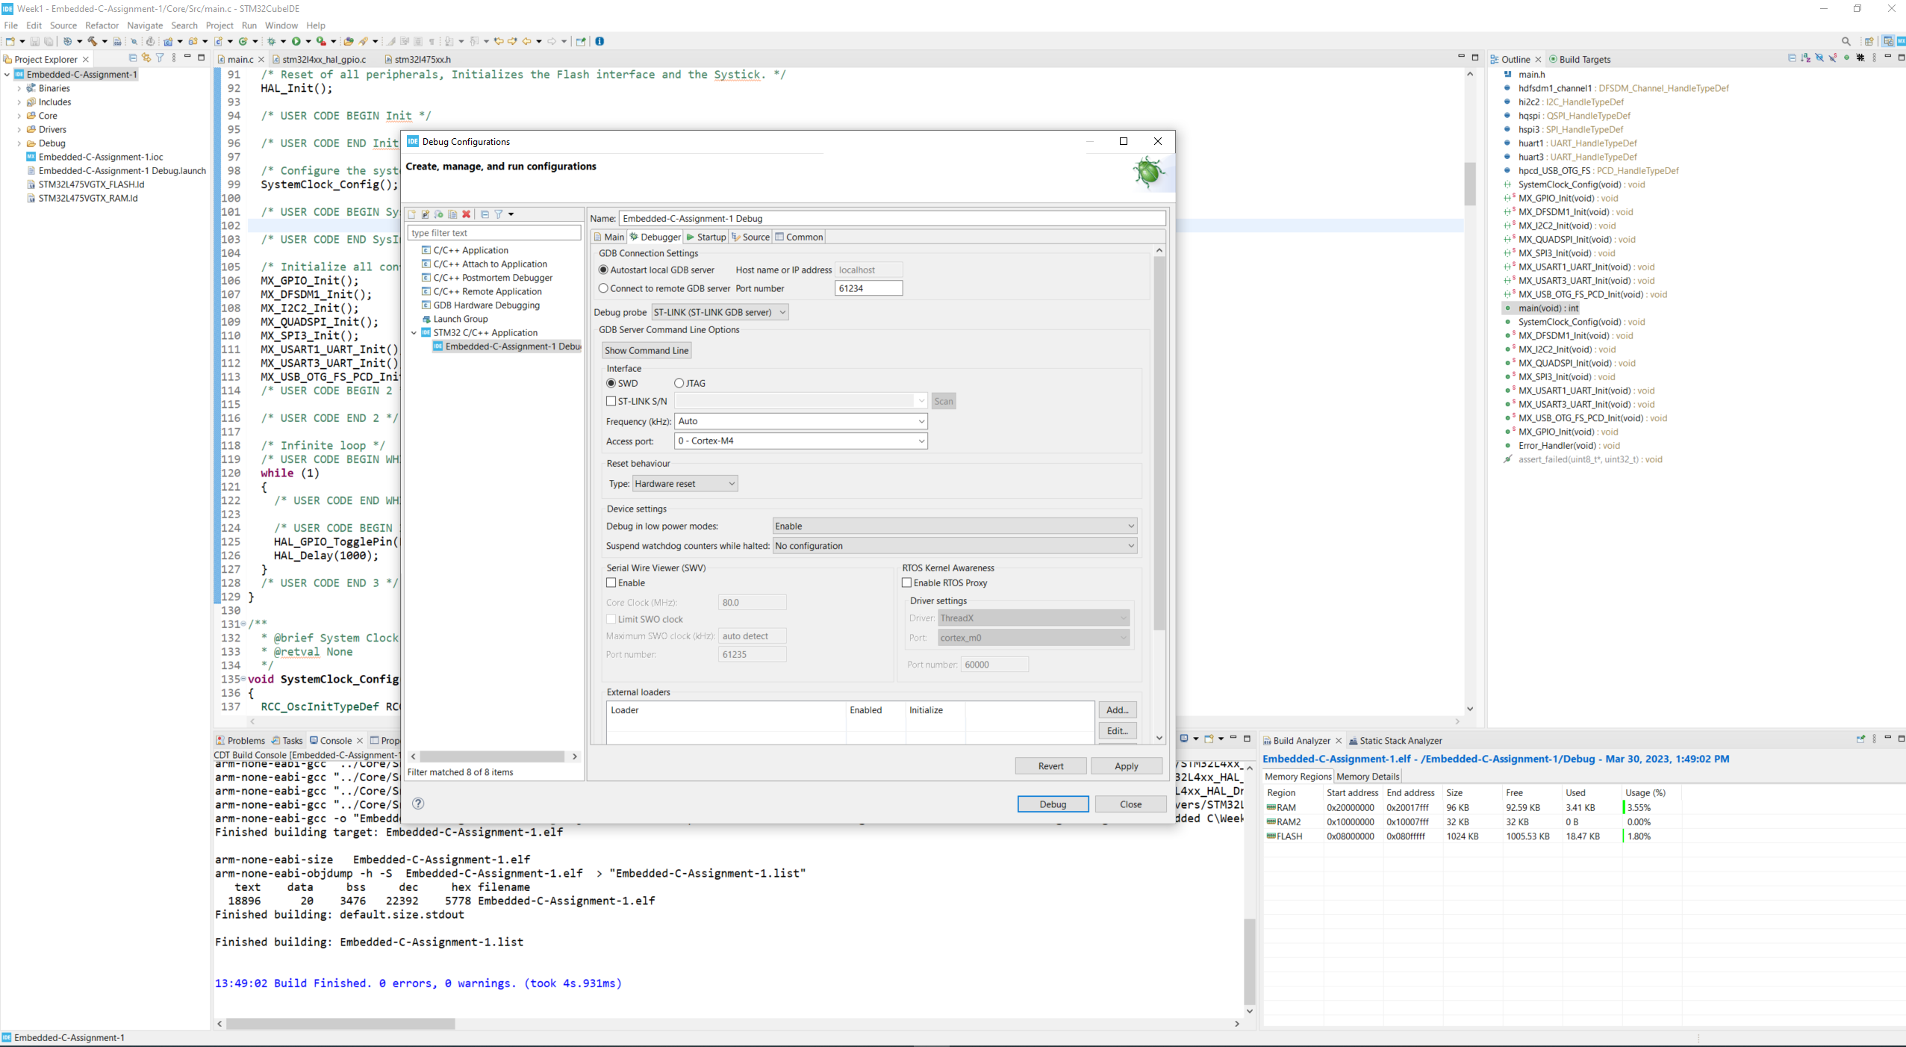
Additional: Step 13. Setup for debug configuration, select SWD as debugger

